Slide 1
The AP American History Jeopardy Game
Advanced Civil War
Click Screen for Next Slide

Slide 2
Vocabulary
Who am I?
Geography
Battles
Employee
Behavior
200
200
200
200
400
400
400
400
600
600
600
600
800
800
800
800
1000
1000
1000
1000

Slide 3
Question: Vocabulary for 200 Points
Define the following.
  Assembly line production-
  Interchangeable Parts-
Answer

Slide 4
Answer: Vocabulary for 200 Points
Assembly line production- This was a major improvement over the cottage assembly of earlier history, it allowed for a more efficient production process and a greater volume of goods for the same or less effort. This helped to provide for the vast ranks of the Northern armies.
Interchangeable Parts- Interchangeable parts describes the uniformity of all goods of one type, so that if one part of a system ceased to function, it could be easily replaced by another. This innovation played a major role in mass production of goods, especially guns.
BACK

Slide 5
Question: Vocabulary for 400 Points
Define the following.
  Army of the Potomac-
  Army of Northern Virginia-
Answer

Slide 6
Answer: Vocabulary for 400 Points
Army of the Potomac- The main fighting force of the Union in the East; it ran through a series of unsuccessful commanders and subsequent losses until General Ulysses S. Grant realized the advantage which it had over its Confederate counterpart, numbers. (Also the first constitutional American Army with non-white soldiers)
Army of Northern Virginia-An elite fighting force of all white males, led by General Robert E. Lee to numerous victories, even though they consistently faced greater numbers and firepower.
BACK

Slide 7
Question: Vocabulary for 600 Points
Define the following.
  Telegraph-
  Railroad-
Answer

Slide 8
Answer: Vocabulary for 600 Points
Telegraph- An innovation of Samuel Morse, this system of wires stretched across the United States before the Civil War and provided instantaneous communication with anyone across the country using a code come up with by the same man; which proved highly valuable during the long, confused years of war, targeted by both sides cavalry.
Railroad- Both a means of communication and transportation, the railroad is a series of metal tracks with an engine on top called a train which would, using mostly steam power, propel itself along these tracks carrying vast loads of both men and material. These were also the targets of numerous raids by both sides, as it was the main supply route short of oxen drawn carraiges.
BACK

Slide 9
Question: Vocabulary for 800 Points
Define and explain the relevance of the following.
  Breech Loading Rifle-
  The Monitor-
Answer

Slide 10
Answer: Vocabulary for 800 Points
Breech Loading Rifle- A breech loading rifle is a rifle loaded, as the name suggests, in the breech of the gun. It was used throughout the Civil War, even if its antiquated muzzle loading cousins were in wide use on both sides. The breech loader was much faster to reload, and primarily using a percussion cap were much more resistant to the weather, as the powder was protected from water damage.
The Monitor- The Monitor was the first ironclad successfully completed by the Union, and included such innovations as a revolving turret, flush toilet, marine screw( propulsion). It was heavily armored and fought the CSS Merrimack to a draw.
BACK

Slide 11
Question: Vocabulary for 1000 Points
Define and explain the relevance of the following.
  Bleeding Kansas-
  Contraband Regiments-
Answer

Slide 12
Answer: Vocabulary for 1000 Points
  Bleeding Kansas- A practice for the Civil War between pro slavery settlers and “free soil” settlers to decide whether to make Kansas a free or slave state. Americans swarmed over the borders to vote on the issue and villages would be formed based on views of slavery and between these towns would be militia raids.
  Contraband Regiments- Contraband regiments are formed from captured Southern slaves after the Emancipation Proclamation while the Union was marching through the South. This proved a devastating moral and political blow to the South (along with regular regiments) as it drew away the Confederacy’s workforce and population.
BACK

Slide 13
Question: Who Am I? for 200 Points
Abraham Lincoln-
Answer

Slide 14
Answer: Who Am I? for 200 Points
Abraham Lincoln-The 16th president of the United States, he ran multiple times, for many offices, his first victory was for the Presidency in 1859. He was not, in fact, a staunch moral opponent of slavery, as is commonly portrayed. He would most likely have proposed a gradual emancipation if given the chance; but when the issue was forced, he stated that slavery had become a political tool, and he would do whatever it took, whether that was for or against emancipation, to hold the Union together.
BACK

Slide 15
Question: Who Am I? for 400 Points
Andrew Johnson-
Answer

Slide 16
Answer: Who Am I? for 400 Points
Andrew Johnson- The 17th president of the United States and a former Senator of Tennessee, he was the only Southern politician to stay in the Senate after his state seceded, which aided the Union in quickly retaking and reforming the state. (Tennessee quickly became the template for Reconstruction throughout the South) His loyalties to the Union while still maintaining his Southern ties quickly allowed him to rise to leadership among the remaining Democrats in the Union and was thus elected for Vice Presidency during Lincoln’s second term. He became president after Lincoln’s assassination in ’65 and was soon backed into a corner by Radical Republicans in Congress on his post Civil War views of the South.
BACK

Slide 17
Question: Who Am I? for 600 Points
54th Massachusetts
Answer

Slide 18
Answer: Who Am I? for 600 Points
54th Massachusetts- The first regiment made entirely of Free Blacks which gained honor and respect from both their enemies and their “friends”. They were led by a White officer and the enlisted could not raise above NCO rank. The majority of the regiment died in a useless assault on a fort of little importance, but proved the bravery of Blacks in the country’s eyes. Suddenly, the Union was issuing new units left and right, adding new vitality to the army.
BACK

Slide 19
Question: Who Am I? for 800 Points
General J.E.B. Stuart-
Lt. General “Stonewall” Jackson-
Answer

Slide 20
Answer: Who Am I? for 800 Points
General J.E.B. Stuart- Stuart was the main cavalry general for the Army of North Virginia under Lee and can be attributed for much of Lee’s victories, as well as losses. His cavalry provided the intelligence network for Lee, as well as its main source of captured supplies. Whenever Lee and Stuart would work together, the Confederacy would win major victories against the Union and its slow, bumbling generals. He dies in an engagement outside of Richmond in 1864.
Lt. General “Stonewall” Jackson- Thomas Jonathan Jackson was an excellent infantry general under Robert E. Lee in the Army of North Virginia. He received the nickname “Stonewall” after a soldier commented at the Battle of Bull Run, “There is Jackson, standing like a stone wall”. This phrase referred to his action at that place when he held a ridge against a massive Union assault, basically saving the day after most of the Southern line crumbled.
BACK

Slide 21
Question: Who Am I? for 1000 Points
Jefferson Davis-
Answer

Slide 22
Answer: Who Am I? for 1000 Points
Jefferson Davis- First and only president of the Confederate Sates of America, his position contradicted the whole formation of the Confederacy. The Confederacy was created to form a purely military alliance between the separatist states, a way to help fight the Union and maintain their independence, but the act of creating an executive branch with any amount of power completely nullified the purpose of seceding. This fact constantly grated upon the representatives of the respective states in their relationship with Jefferson Davis. His term as president if the Confederacy won would have been up six years after he was elected and could never run again.
BACK

Slide 23
Question: Geography for 200 Points
Explain the relevance of both the location and the importance of Richmond.
Answer

Slide 24
Answer: Geography for 200 Points
Richmond was the capital of the new Confederate States of America. It was located very near the U.S.- C.S. border. Also very close to Washington D.C. making this area a much contested land. Most of the major battles of the war are fought around Northern Virginia and Southern Pennsylvania.
BACK

Slide 25
Question: Geography for 400 Points
Explain the relevance of both the location and the importance of
Washington D.C.
Answer

Slide 26
Answer: Geography for 400 Points
Washington D.C. is the capital of the United States of America. It is located in its own state like entity called the District of Columbia and is located bordering Maryland in Virginia as the result of an underhanded deal in the beginning of the nation. This proves dangerous during the Civil War when it becomes the front lines of the war with General Lee getting within sight of the city itself. The capital becomes a fortress city with tensions between neighbors to rival that of Maryland, which flip flopped on the secession issue throughout the war.
BACK

Slide 27
Question: Geography for 600 Points
Explain the relevance of both the location and the importance of Philadelphia.
Answer

Slide 28
Answer: Geography for 600 Points
Philadelphia is another major Union city very close to the front lines. It becomes another major target for Lee’s army and is the backup capital for the Northern government if Washington D.C. falls. It is also a major manufacturing center in the North and is an important railway hub.
BACK

Slide 29
Question: Geography for 800 Points
Explain the relevance of both the location and the importance of
New York City.
Answer

Slide 30
Answer: Geography for 800 Points
New York City is both a large population center and manufacturing city. Also serving as a major port for the Union, the city was a site of many race and anti conscription (draft) riots. Martial law was eventually declared, and troops were sent from the front lines to go fight the citizens they were striving to protect. A major center of racist tension, African Americans were sometimes lynched in the riots that swept the city.
BACK

Slide 31
Question: Geography for 1000 Points
Explain the relevance of both the location and the importance of the
Cumberland Valley
Answer

Slide 32
Answer: Geography for 1000 Points
The Cumberland Valley is an area fought over during many of the battles in the Civil War. A very fertile region, it also sports a major railway between Pennsylvania and Maryland.
BACK

Slide 33
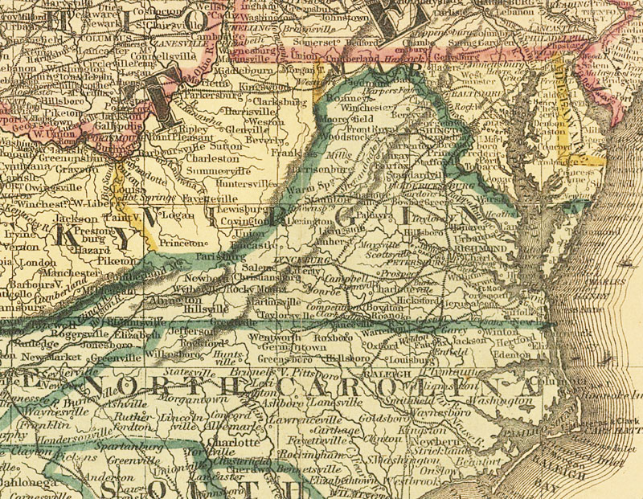
Question: Battles for 200 Points
Explain the battle of Gettysburg. Who are the two commanders? Where is it? When is it? Who won? Why was it important?
Answer

Slide 34
Answer: Battles for 200 Points
The Battle of Gettysburg was located near Gettysburg, Pennsylvania and took place in July of 1863, beginning on July 1st and ending on Independence Day. This was a major turning point in the war as Meade was the first Union commander able to defeat the Great General Lee. It also halted Lee’s basically uncontested march into the North and allowed the country to unify around the president as he gave his Gettysburg Address. This battle was one of the bloodiest of the war, killing more than 51,000 Americans in three days.
BACK

Slide 35
Question: Battles for 400 Points
Explain the battle of Antietam. Who are the two commanders? Where is it? When is it? Who won? Why was it important?
Answer

Slide 36
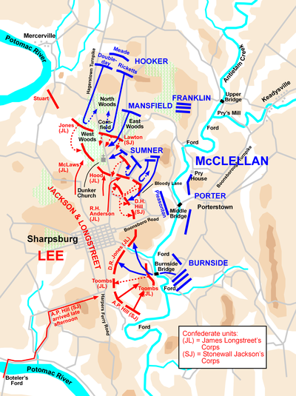
Answer: Battles for 400 Points
The battle of Antietam took place near the town of Sharpsburg, Maryland in September of 1862. This was the first battle which the Union could at least claim a victory even if it was more of a draw than a distinct victory. But McClellan forced Lee to halt his advance and retreat to Northern Virginia. The main engagement of the battle occurred on the 17th and killed over 20,000 Americans combined; a greater number of casualties than any other day in American history. The forced retreat of Lee allowed Lincoln to deliver his Emancipation Proclamation. A statement which freed all states still in rebellion; not only demonstrating that he stilled considered the Confederacy as a part of the Union, but also answered definitively the cries of the Radical Republicans and abolitionists who wanted full emancipation for all slaves.
BACK

Slide 37
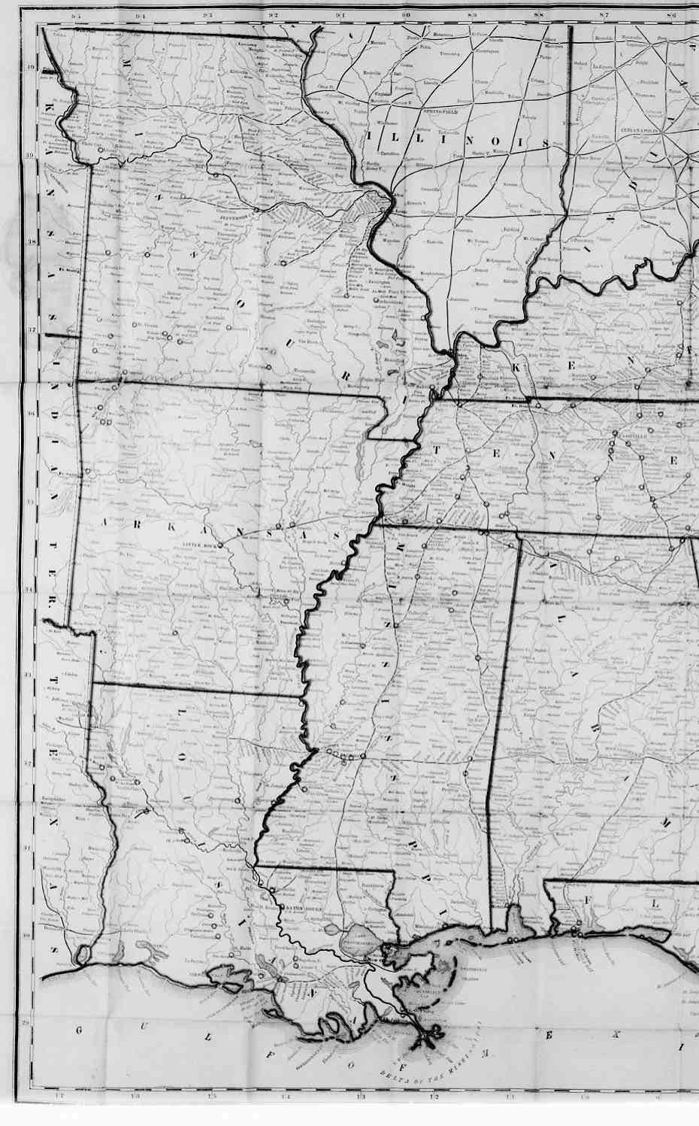
Question: Battles for 600 Points
Explain the battle of Vicksburg. Who are the two commanders? Where is it? When is it? Who won? Why was it important?
Answer

Slide 38
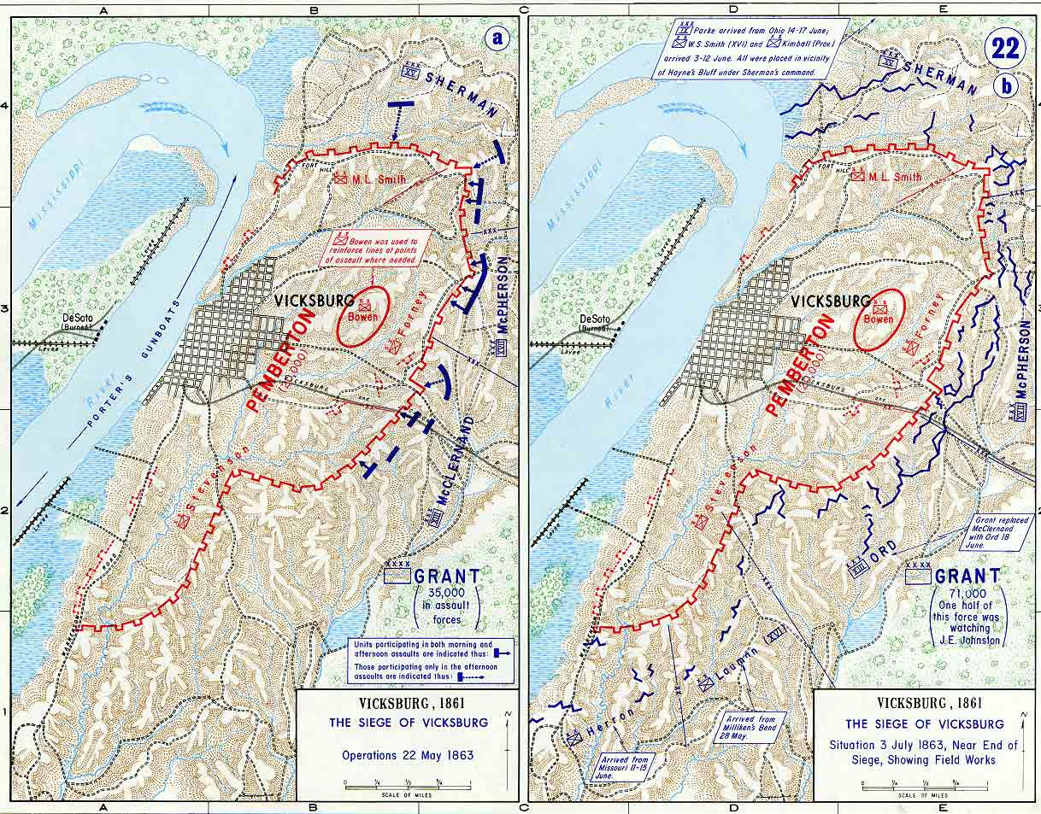
Answer: Battles for 600 Points
The Battle of Vicksburg took place on the Mississippi river at the city of Vicksburg, an important strategic goal as it is a major choke point of the Mississippi. It was the final major battle in the Vicksburg campaign, a siege of the city that took nearly three months, inflicting just as many casualties with disease as with bullets. Finally, the siege ended on July 4th when General Pemberton sent a note to Grant detailing his surrender. Grant entered the city and released the demoralized, sick, starving, Confederate soldiers on parole.
BACK

Slide 39
Question: Battles for 800 Points
Explain the First Battle of Bull Run. Who are the two commanders? Where is it? When is it? Who won? Why was it important?
Answer

Slide 40
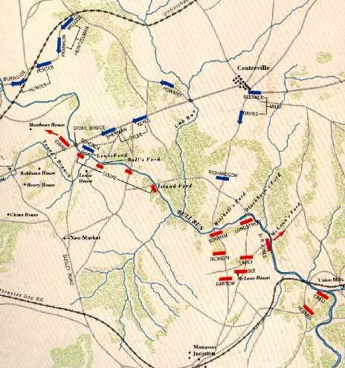
Answer: Battles for 800 Points
The First battle of Bull Run took place on July 21st in 1861 near the creek of Bull Run in Virginia. It was the first battle where the Confederacy and the Union fought on land to start off the Civil War. General McDowell, armed with around 30,000 men he positioned his forces to block any Confederate advance by the 22,000 troops of General Beauregard. It was a standard straight up battle of the old school; the two sides lining up and shooting at each other, with spectators on both sides watching at the sidelines. The Union was repulsed by “Stonewall” Jackson after the rest of the Southern army began to retreat. It was his stand here that gave him his permanent nickname Stonewall after a man commented, “There is Jackson, standing like a stone wall.” When Southern reinforcements finally arrived, the Union was defeated and forced to retreat. The, “Greatest Army in the world” was defeated the first time it took the field. It also predicted the general outline of most of the battles to come, the South having less, but more spirited, trained, and led, men; versus the North with their massive numbers and poor generals.
BACK

Slide 41
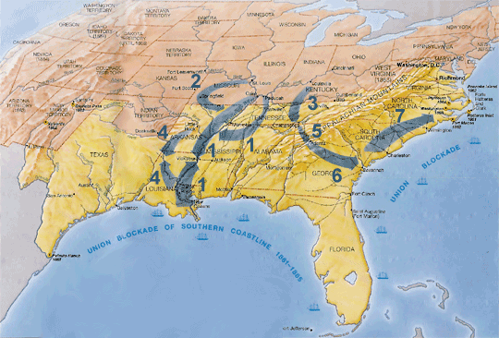
Question: Battles for 1000 Points
Explain “Sherman’s March to the Sea”.
Answer

Slide 42
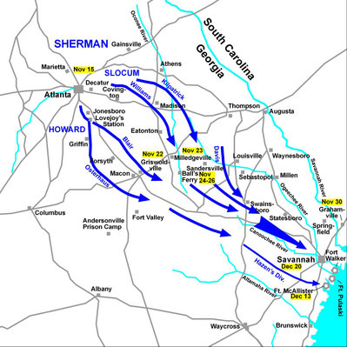
Answer: Battles for 1000 Points
Sherman’s March to the Sea was one of the final campaigns in the war during the winter of 1864. General William Tecumseh Sherman was ordered to take Savannah by Christmas at any cost. This campaign was the first true total war. A wide swath of land about 50 miles across was literally ripped out of the earth in front of Sherman’s advancing regiments. They completely destroyed anything in their path (short of peaceful civilians). It devastated the countryside and truly brought the war home to the Confederacy. This was the final blow before the South began to crumble. Signs of the campaign can still be seen to this day in Georgia as railroad ties were literally heated and wrapped around trees. All livestock was destroyed and buildings burnt, slaves flocked to Union lines and the destruction of the Confederacy’s ability to wage war was complete. Savannah was taken in time for Christmas with Sherman’s message to President Lincoln, “I beg to present you as a Christmas gift the City of Savannah, with one hundred and fifty guns and plenty of ammunition, also about twenty-five thousand bales of cotton."
BACK

Slide 43
Play the Jeopardy Game
Learn my Vocabulary (Coming Soon)
Learn the Supreme Court Judges

Slide 44
The Justices of the Supreme Court
John G. Roberts, Jr.
John Paul Stevens
Antonin Scalia
Anthony M. Kennedy
Sandra Day O’Conner (Retired)
David Hackett Souter
Clarence Thomas
Ruth Bader Ginsburg
Stephen G. Breyer
Samuel Anthony Alito, Jr.

Slide 45
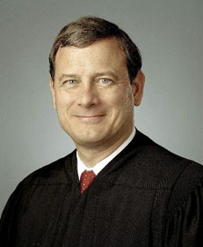
John G. Roberts, Jr.
Chief Justice of the United States, was born in Buffalo, New York, January 27, 1955. He married Jane Marie Sullivan in 1996 and they have two children - Josephine and John. He received an A.B. from Harvard College in 1976 and a
J.D. from Harvard Law School in 1979. He served as a law clerk for Judge Henry J.Friendly of the United States Court of Appeals for the Second Circuit from 1979-1980 and as a law clerk for then-Associate Justice William H. Rehnquist of the Supreme Court of the United States during the 1980 Term. He was Special Assistant to the Attorney General,
U.S. Department of Justice from 1981-1982, Associate Counsel to President Ronald Reagan, White House Counsel抯 Office from 1982-1986, and Principal Deputy Solicitor General, U.S. Department of Justice from 1989-1993. From 1986-1989 and 1993-2003, he practiced law in Washington, D.C. He was appointed to the United States Court of Appeals for the District of Columbia Circuit in 2003. President George W. Bush nominated him as Chief Justice of the United States, and he took his seat on September 29, 2005.

Slide 46
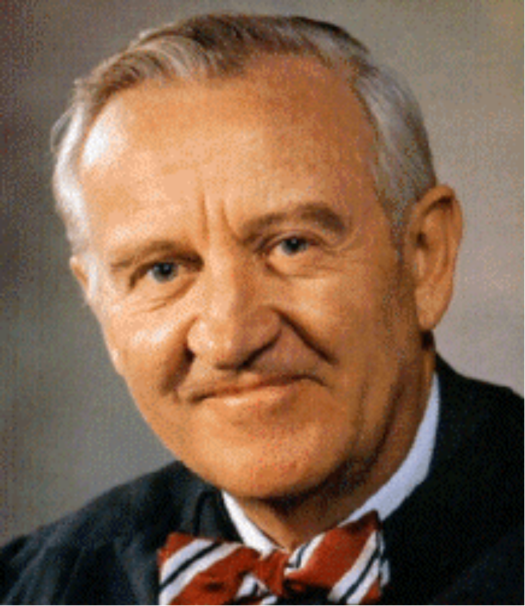
John Paul Stevens
John Paul Stevens, Associate Justice, was born in Chicago, Illinois, April 20, 1920.He married Maryan Mulholland, and has four children - John Joseph (deceased), Kathryn, Elizabeth Jane, and Susan Roberta. He received an A.B. from the University of Chicago, and a J.D. from Northwestern University School of Law. He served in the United States Navy from 1942-1945, and was a law clerk to Justice Wiley Rutledge of the Supreme Court of the United States during the 1947 Term. He was admitted to law practice in Illinois in 1949. He was Associate Counsel to the Subcommittee on the Study of Monopoly Power of the Judiciary Committee of the U.S. House of Representatives, 1951-1952, and a member of the Attorney General National Committee to Study Antitrust Law, 1953-1955. He was Second Vice President of the Chicago Bar Association in 1970. From 1970-1975, he served as a Judge of the United States Court of Appeals for the Seventh Circuit. President Ford nominated him as an Associate Justice of the Supreme Court, and he took his seat December 19, 1975

Slide 47
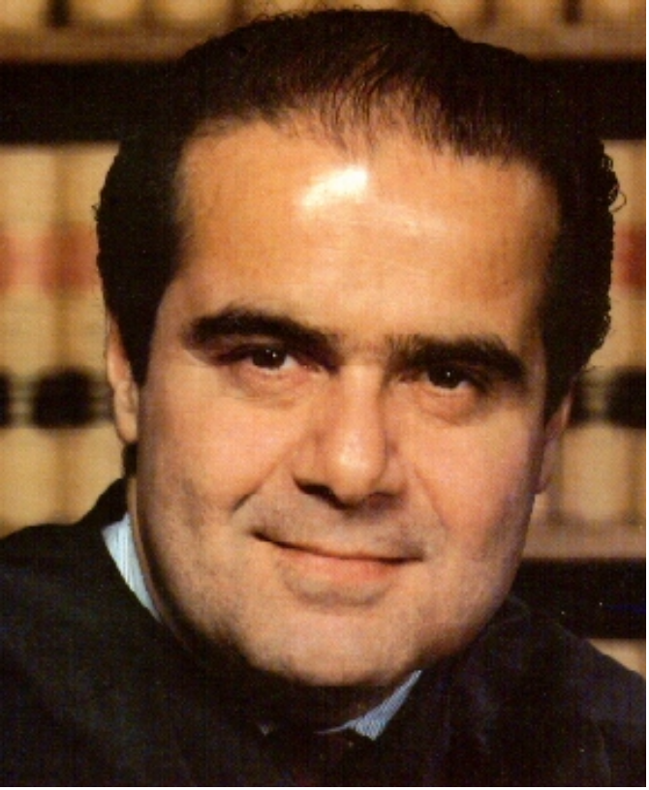
Antonin Scalia
Antonin Scalia, Associate Justice, was born in Trenton, New Jersey, March 11, 1936.He married Maureen McCarthy and has nine children - Ann Forrest, Eugene, John Francis, Catherine Elisabeth, Mary Clare, Paul David, Matthew, Christopher James, and MargaretJane. He received his A.B. from Georgetown University and the University of Fribourg, Switzerland, and his LL.B. from Harvard Law School, and was a Sheldon Fellow of Har-vard University from 1960-1961. He was in private practice in Cleveland, Ohio from 1961-1967, a Professor of Law at the University of Virginia from 1967-1971, and a Professor of Law at the University of Chicago from 1977-1982, and a Visiting Professor of Law at Georgetown University and Stanford University. He was chairman of the American Bar Association抯 Section of Administrative Law, 1981-1982, and its Conference of SectionChairmen, 1982-1983. He served the federal government as General Counsel of the Officeof Telecommunications Policy from 1971-1972, Chairman of the Administrative Conference of the United States from 1972 1974, and Assistant Attorney General for the Office ofLegal Counsel from 1974-1977. He was appointed Judge of the United States Court of Appeals for the District of Columbia Circuit in 1982. President Reagan nominated him asan Associate Justice of the Supreme Court, and he took his seat September 26, 1986.

Slide 48
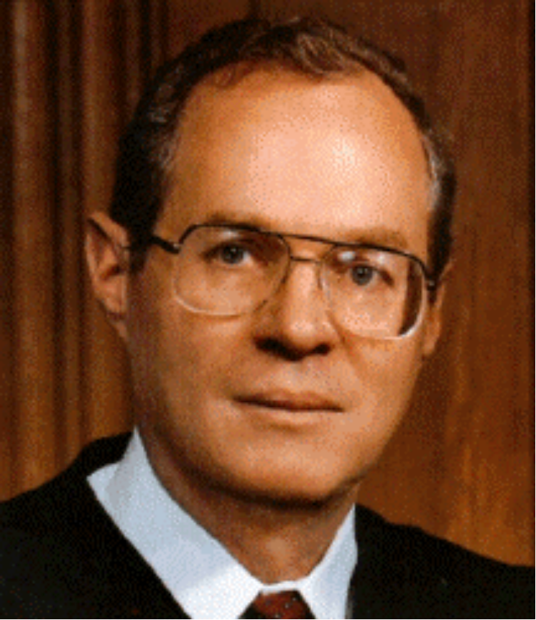
Anthony M. Kennedy
Anthony M. Kennedy, Associate Justice, was born in Sacramento, California, July 23, 1936. He married Mary Davis and has three children. He received his B.A. from Stanford University and the London School of Economics, and his LL.B. from Harvard LawSchool. He was in private practice in San Francisco, California from 1961-1963, as well as in Sacramento, California from 1963-1975. From 1965 to 1988, he was a Professor of
Constitutional Law at the McGeorge School of Law, University of the Pacific. He has served in numerous positions during his career, including a member of the California Army National Guard in 1961, the board of the Federal Judicial Center from 1987-1988, and two committees of the Judicial Conference of the United States: the Advisory Panel on Financial Disclosure Reports and Judicial Activities, subsequently renamed the Advisory Committee on Codes of Conduct, from 1979-1987, and the Committee on Pacific Territories from 1979-1990, which he chaired from 1982-1990. He was appointed to the United States Court of Appeals for the Ninth Circuit in 1975. President Reagan nominated him as an Associate Justice of the Supreme Court, and he took his seat February 18, 1988.

Slide 49
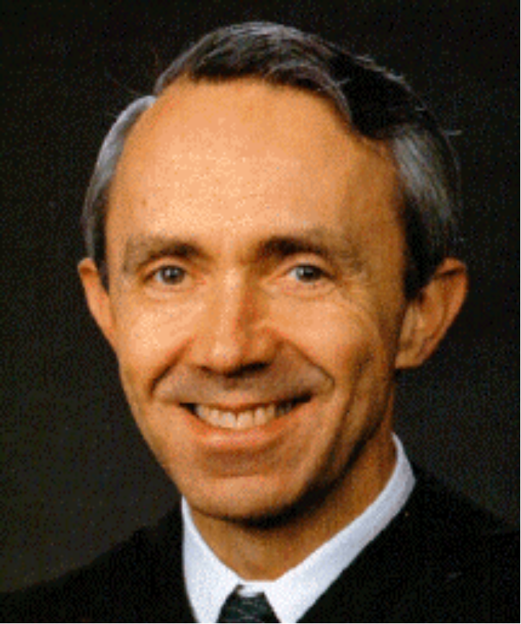
David Hackett Souter
David Hackett Souter, Associate Justice, was born in Melrose, Massachusetts,September 17, 1939. He was graduated from Harvard College, from which he received his A.B. After two years as a Rhodes Scholar at Magdalen College, Oxford, he received an A.B. in Jurisprudence from Oxford University and an M.A. in 1989. After receivingan LL.B. from Harvard Law School, he was an associate at Orr and Reno in Concord,New Hampshire from 1966 to 1968, when he became an Assistant Attorney General of NewHampshire. In 1971, he became Deputy Attorney General and in 1976, Attorney General of New Hampshire. In 1978, he was named an Associate Justice of the Superior Court of New Hampshire, and was appointed to the Supreme Court of New Hampshire as an AssociateJustice in 1983. He became a Judge of the United States Court of Appeals for the First Circuit on May 25, 1990. President Bush nominated him as an Associate Justice of the Supreme Court, and he took his seat October 9, 1990.

Slide 50
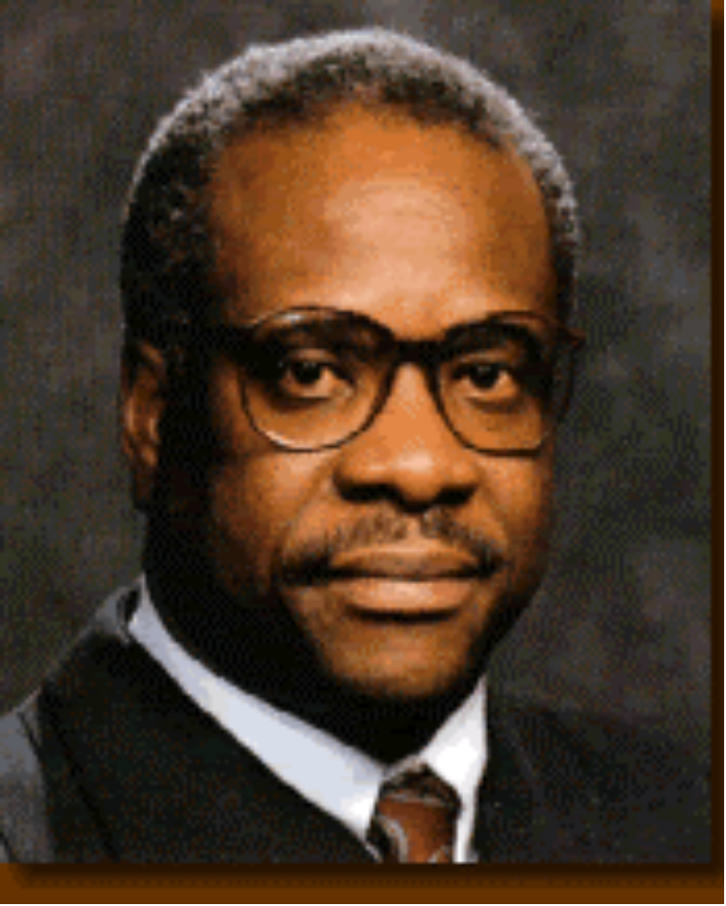
Clarence Thomas
Clarence Thomas, Associate Justice, was born in the Pin Point community of Georgia near Savannah June 23, 1948. He married Virginia Lamp in 1987 and has one child, JamalAdeen, by a previous marriage. He attended Conception Seminary and received an A.B., cum laude, from Holy Cross College, and a J.D. from Yale Law School in 1974. He was admitted to law practice in Missouri in 1974, and served as an Assistant Attorney General of Missouri from 1974-1977, an attorney with the Monsanto Company from 1977-1979, and Legislative Assistant to Senator John Danforth from 1979-1981. From 1981-1982, he served as Assistant Secretary for Civil Rights, U.S. Department of Education, and as Chairman of the U.S. Equal Employment Opportunity Commission from 1982?990. He became a Judge of the United States Court of Appeals for the District of Columbia Circuitin 1990. President Bush nominated him as an Associate Justice of the Supreme Court, and he took his seat October 23, 1991.

Slide 51
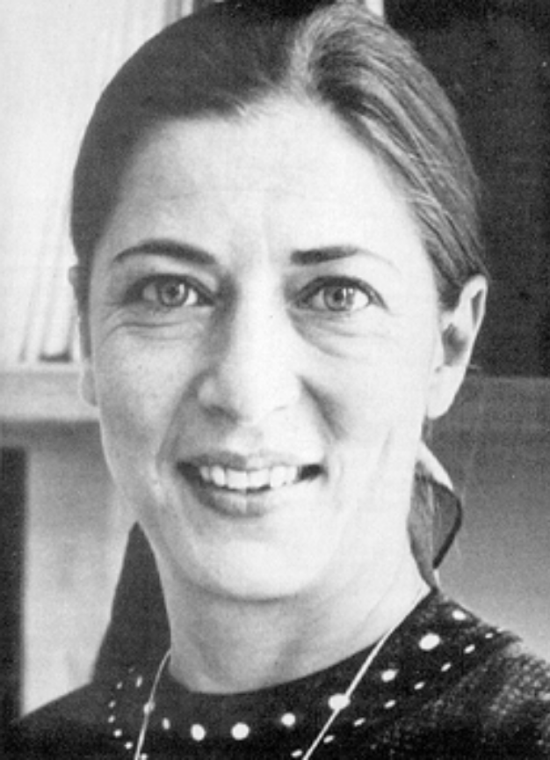
Ruth Bader Ginsburg
Ruth Bader Ginsburg, Associate Justice, was born in Brooklyn, New York, March 15, 1933. She married Martin D. Ginsburg in 1954, and has a daughter, Jane, and a son, James. She received her B.A. from Cornell University, attended Harvard Law School, and received her LL.B. from Columbia Law School. She served as a law clerk to the Honorable Edmund L. Palmieri, Judge of the United States District Court for the Southern District of New York, from 1959-1961. From 1961-1963, she was a research associate and then associate director of the Columbia Law School Project on International Procedure. She was a Professor of Law at Rutgers University School of Law from 1963-1972, and Columbia Law School from 1972-1980, and a fellow at the Center for Advanced Study in the Behavioral Sciences in Stanford, California from 1977-1978. In 1971, she was instrumental in launching the Women抯 Rights Project of the American Civil Liberties Union, and served as the ACLU General Counsel from 1973-1980, and on the National Board of Directors from 1974-1980. She was appointed a Judge of the United States Court of Appeals for the District of Columbia Circuit in 1980. President Clinton nominated her as an Associate Justice of the Supreme Court, and she took her seat August 10, 1993.

Slide 52
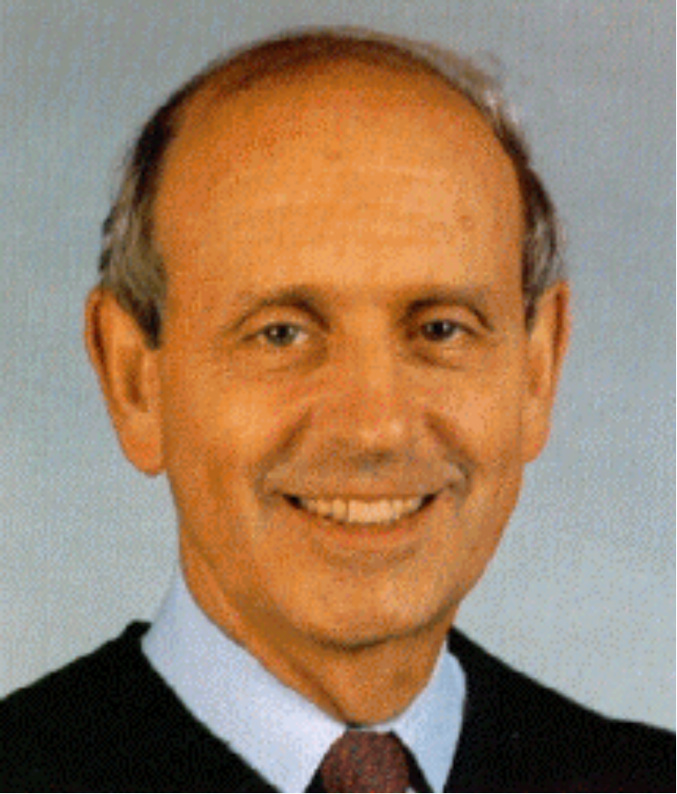
Stephen G. Breyer
Stephen G. Breyer, Associate Justice, was born in San Francisco, California, August 15, 1938. He married Joanna Hare in 1967, and has three children - Chloe, Nell, and Michael. He received an A.B. from Stanford University, a B.A. from Magdalen College, Oxford, and an LL.B. from Harvard Law School. He served as a law clerk to Justice Arthur Goldberg of the Supreme Court of the United States during the 1964 Term, as a Special Assistant to the Assistant U.S. Attorney General for Antitrust, 1965-1967, as an Assistant Special Prosecutor of the Watergate Special Prosecution Force, 1973, as Special Counsel of the U.S. Senate Judiciary Committee, 1974-1975, and as Chief Counsel of the committee, 1979-1980. He was an Assistant Professor, Professor of Law, and Lecturer at Harvard Law School, 1967-1994, a Professor at the Harvard University Kennedy School of Government, 1977-1980, and a Visiting Professor at the College of Law, Sydney, Australia and at the University of Rome. From 1980-1990, he served as a Judge of the United States Court of Appeals for the First Circuit, and as its Chief Judge, 1990-1994. He also served as a member of the Judicial Conference of the United States, 1990-1994, and of the United States Sentencing Commission, 1985-1989. President Clinton nominated him as an Associate Justice of the Supreme Court, and he took his seat August 3, 1994.

Slide 53
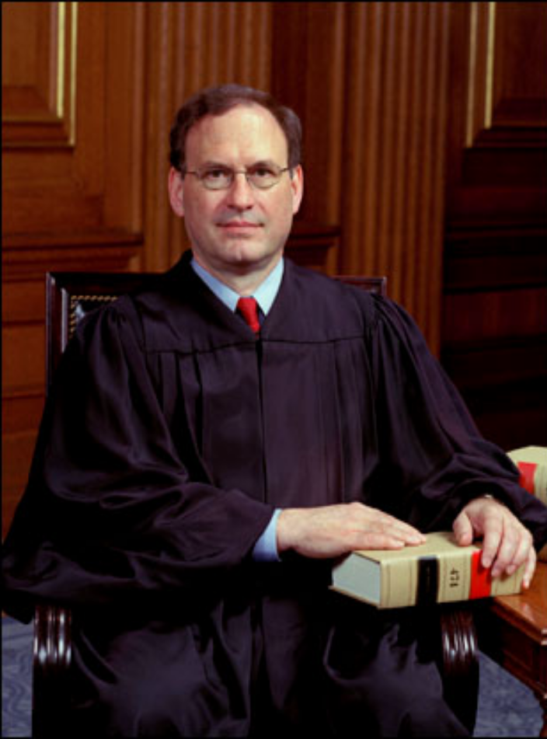
Samuel Anthony Alito, Jr.
Samuel Anthony Alito, Jr., Associate Justice, was born in Trenton, New Jersey, April 1, 1950. He married Martha-Ann Bomgardner in 1985, and has two children -Philip and Laura. He served as a law clerk for Leonard I. Garth of the United States Court of Appeals for the Third Circuit from 1976-1977. He was Assistant U.S. Attorney, District of New Jersey, 1977-1981, Assistant to the Solicitor General, U.S. Department of Justice, 1981-1985, Deputy Assistant Attorney General, U.S. Department of Justice, 1985-1987, and U.S. Attorney, District of New Jersey, 1987-1990. He was appointed to the United States Court of Appeals for the Third Circuit in 1990. President George W. Bush nominated him as an Associate Justice of the Supreme Court, and he took his seat on January 31, 2006.

Slide 54
Extra Information
The emancipation Proclamation did not in fact immediately free any slaves. It released only those slaves who were still located in the states in rebellion. A very oddly worded statement, it attempts to allay the fears of the border states while at the same time appeasing the abolitionists without actually taking any action.
BACK

Slide 55
Bonus Question for 400 points
Explain how you can tell which side won a battle during the Civil War when you hear the name of the battle.
BACK

Slide 56
Bonus Question 600 points
Explain the Anaconda Plan.

